Slide 1
LMDB
Георгий Миронов
б05-927
МФТИ
2022

Slide 2
Agenda
LMDB positioning
review of three main work principes
comparison with SQLite

Slide 3
LMBD positioning
Memory-mapped files
B+ tree
Copy-on-write

Slide 4
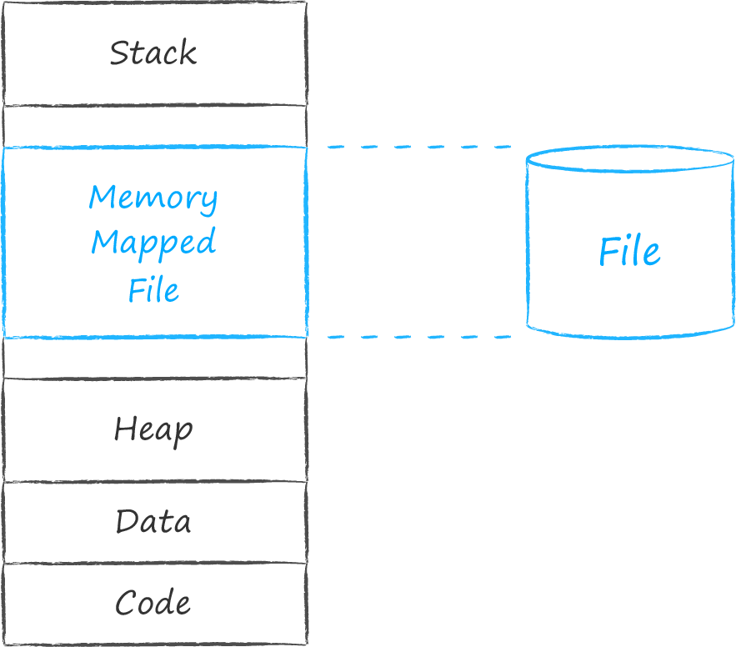
Memory-mapped files
Delegation of data maintenance responsibilities
No dynamic allocations
No locks due to synchronization

Slide 5
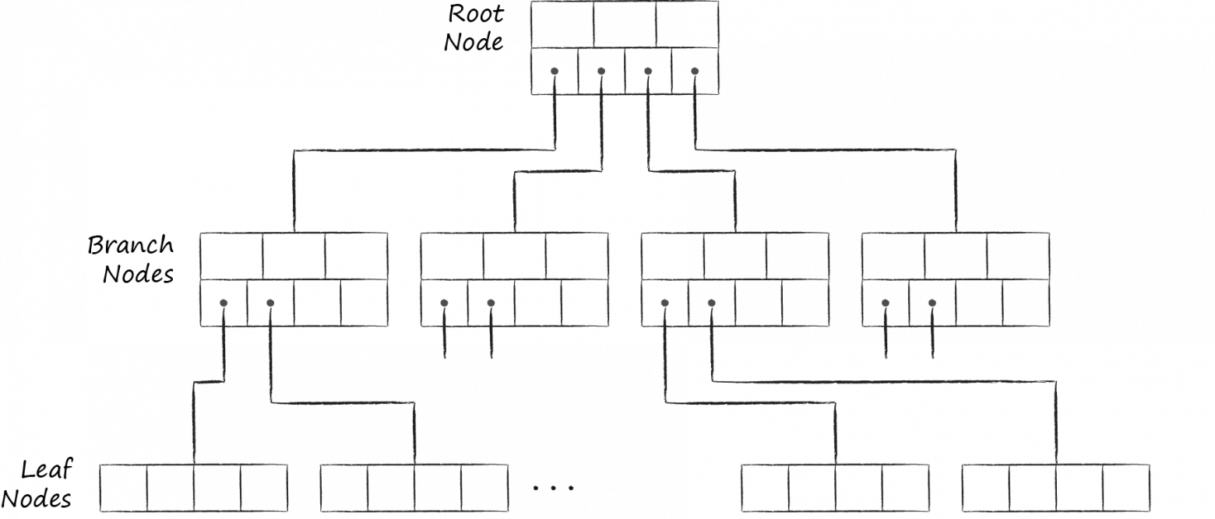
B+ tree
root is db concept
leave is key-value data
branch is navigation node

Slide 6
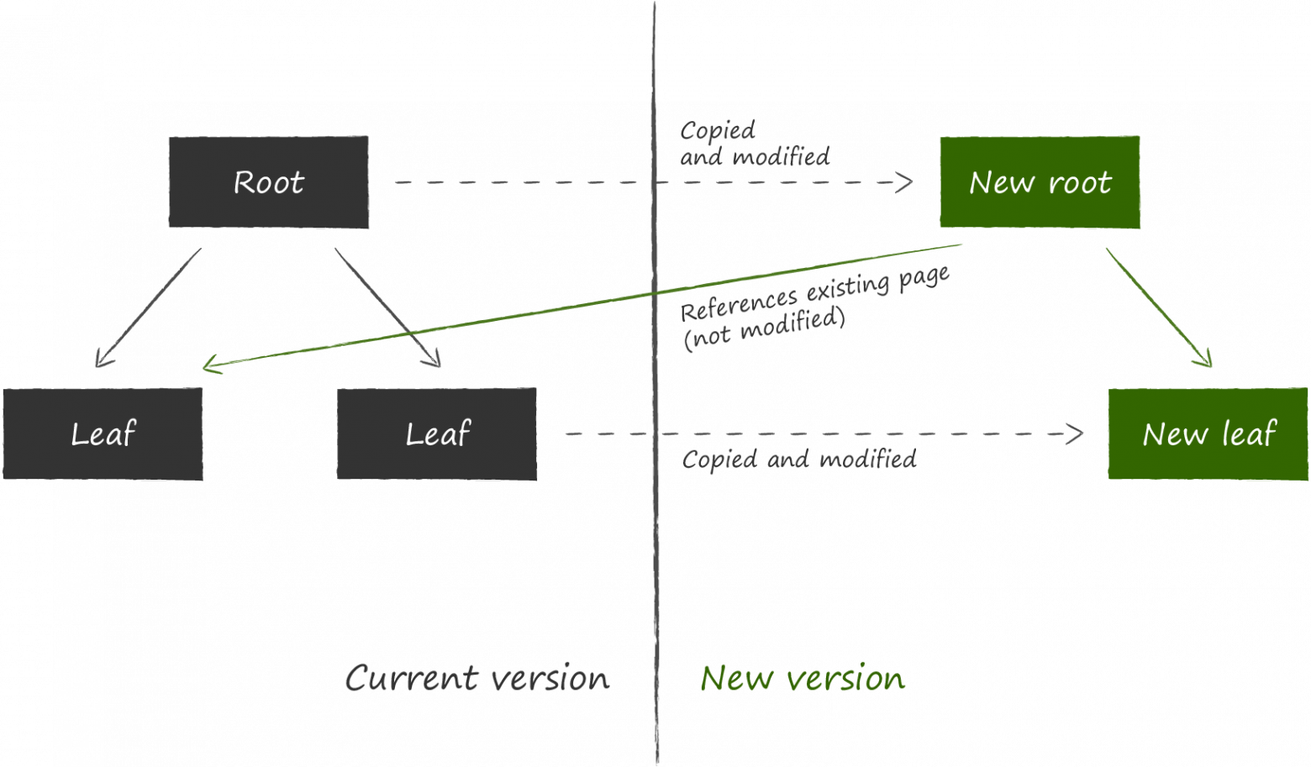
Copy-On-Write
transaction sense
read transaction
write transaction

Slide 7
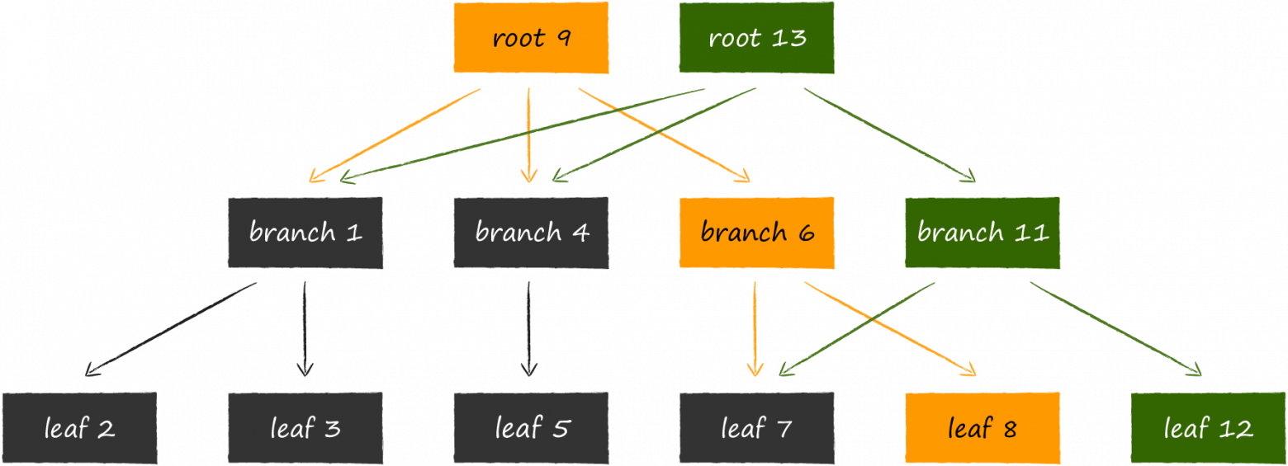
Copy-On-Write

Slide 8
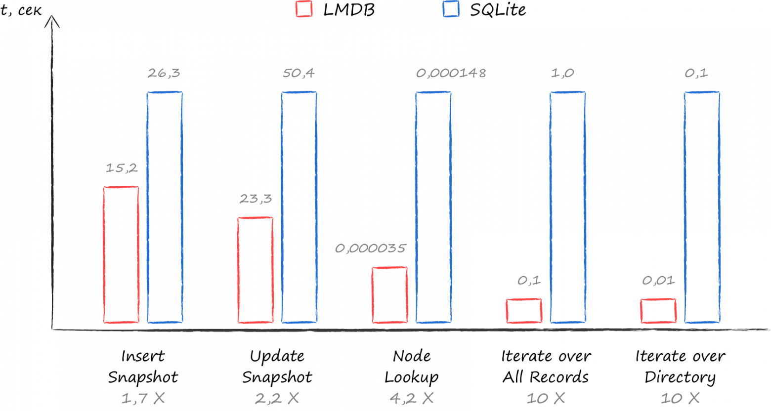
Time test

Slide 9
Summary
LMDB is fast
LMDB is simple
LMDB is well done, be like LMDB

Slide 10
References
https://habr.com/ru/company/vk/blog/480850/

